Slide 1

Continuous Integration
Mark C. Miller Lawrence Livermore National Laboratory
Software Productivity Track, ATPESC 2020
See slide 2 for license details
Notes:
Designed to be 15 Minute Talk + 20 minutes for the live Travis CI demo

Slide 2
License, Citation and Acknowledgements
License and Citation
This work is licensed under a Creative Commons Attribution 4.0 International License (CC BY 4.0).
The requested citation the overall tutorial is: David E. Bernholdt, Anshu Dubey, Mark C. Miller, Katherine M. Riley, and James M. Willenbring, Software Productivity Track, in Argonne Training Program for Extreme Scale Computing (ATPESC), August 2020, online. DOI: 10.6084/m9.figshare.12719834
Individual modules may be cited as Speaker, Module Title, in Software Productivity Track…
Acknowledgements
Additional contributors include: Patricia Grubel, Rinku Gupta, Mike Heroux, Alicia Klinvex, Jared O’Neal, David Rogers, Deborah Stevens
This work was supported by the U.S. Department of Energy Office of Science, Office of Advanced Scientific Computing Research (ASCR), and by the Exascale Computing Project (17-SC-20-SC), a collaborative effort of the U.S. Department of Energy Office of Science and the National Nuclear Security Administration.
This work was performed in part at the Argonne National Laboratory, which is managed by UChicago Argonne, LLC for the U.S. Department of Energy under Contract No. DE-AC02-06CH11357.
This work was performed in part at the Oak Ridge National Laboratory, which is managed by UT-Battelle, LLC for the U.S. Department of Energy under Contract No. DE-AC05-00OR22725.
This work was performed in part at the Lawrence Livermore National Laboratory, which is managed by Lawrence Livermore National Security, LLC for the U.S. Department of Energy under Contract No. DE-AC52-07NA27344. IM Release #LLNL-PRES-813357
This work was performed in part at Sandia National Laboratories. Sandia National Laboratories is a multi-mission laboratory managed and operated by National Technology and Engineering Solutions of Sandia, LLC., a wholly owned subsidiary of Honeywell International, Inc., for the U.S. Department of Energy’s National Nuclear Security Administration under contract DE-NA0003525.

Slide 3
What is Continuous Integration (CI) Testing
Testing
Focused, critical functionality (infrastructure), fast, independent, orthogonal, complete, …
Existing test suites often require re-design/refactoring for CI
Integration
Changes across key branches merged & tested to ensure the “whole” still works
Develop, develop, develop, merge, merge, merge, test, test, test…NO!
Develop, merge, test, develop, merge, test, develop, merge, test…YES!
Continuous
Changes tested every commit and/or pull-request (like auto-correct)
CI generally implies a lot of automation

Slide 4
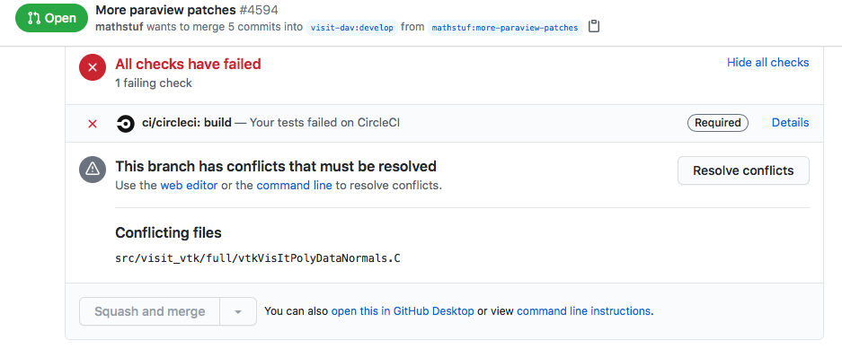
Automated Testing vs. Continuous Integration (CI) Testing
Automated Testing: Software that automatically performs tests and reliably detects and reports anomalous behaviors/outcomes.
Examples: Auto-test, CTest/CDash, nightly testing, `make check’
Potential issues: change attribution, timeliness of results, multiple branches of development
Continuous Integration (CI): automated testing performed at high frequency and fine granularity aimed at preventing code changes from breaking key branches of development (e.g. main)
Example: Disabled/enabled “Merge Pull Request” button on GitHub
Potential issues: extreme automation, test granularity, coverage, 3rd-party services/resources

Slide 5
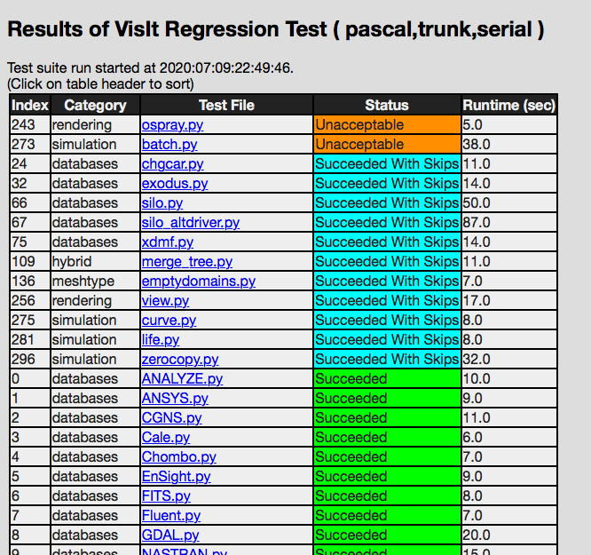
Examples…
Automated Nightly Testing Dashboard Lives “next to” your development work
CI Testing Lives embedded in your development work

Slide 6
CI Testing is one part of the “Shift Left” movement in DevOps
Advantage

Slide 7
What can make CI Difficult
Common situations
Advanced situations
Just getting started
Many technologies/choices; often in the ”cloud”
Solution: start small, simple, build up
Developing suitable tests
Many project’s existing tests not suitable for CI
Solution: Simplify/refactor and/or sub-setting test suite
Ensuring sufficient coverage
Some changes to code never get tested
Solution: tools to measure it, enforce always increasing
Defining failure for many configurations
Bit-for-bit (exact) match vs. fuzzy match
Solution: absolute/relative tolerances → AI/ML
Numerous 3rd party libraries (TPLs)
Compiling takes too long
Solution: cache pre-built TPLs, containers
Performance testing
Avoid time-, space-, scaling-performance degradation
Solution: Perf. instrumentation and scheduled testing

Slide 8
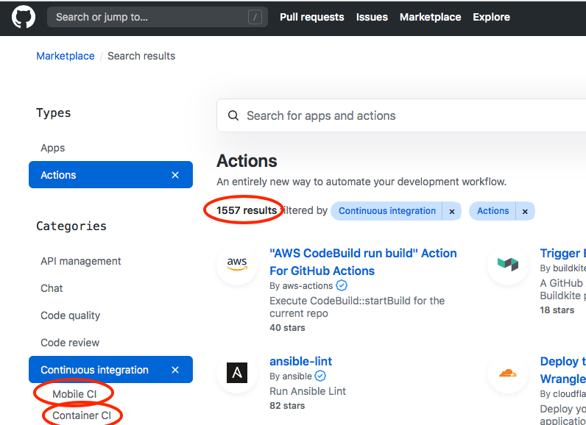
CI Resources (Where do jobs run?)
Free Cloud Resources (many free on GitHub, BitBucket, GitLab, etc.)
Travis-CI, Circle-CI, AppVeyor, Azure Pipelines,…
All launch a VM (Linux variants, Windows and OSX)
Constrained in time/size, config. (e.g. GPU type/count)
Not always suitable for large, HPC projects due to need for longer than usual time to run
Site-local Resources
Examples: Bamboo @ LLNL, Jenkins @ ANL, Travis+CDash @ NERSC, etc.
ECP Program: GitLab-CI @ ANL, LANL, LLNL, NERSC, ORNL, SNL
Create your own by setting up resources/services

Slide 9


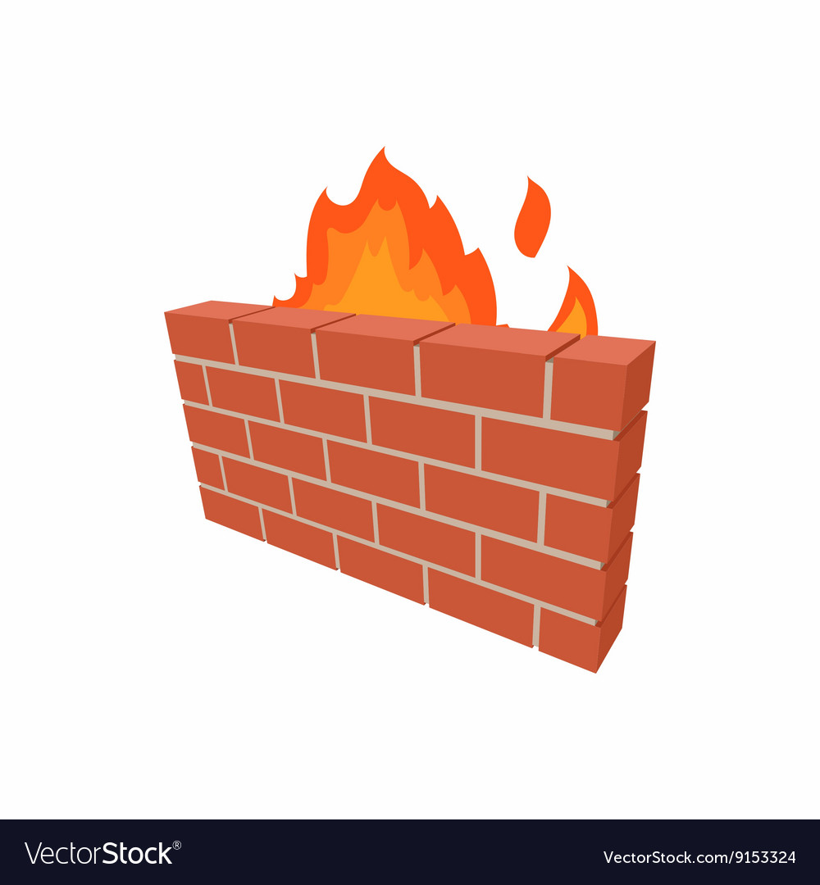


Examples…
travis-ci.com
github.com
Your code repository
Your CI Resources
LLNL
NERSC
bitbucket.llnl.gov
gitlab.nersc.gov
You

Slide 10
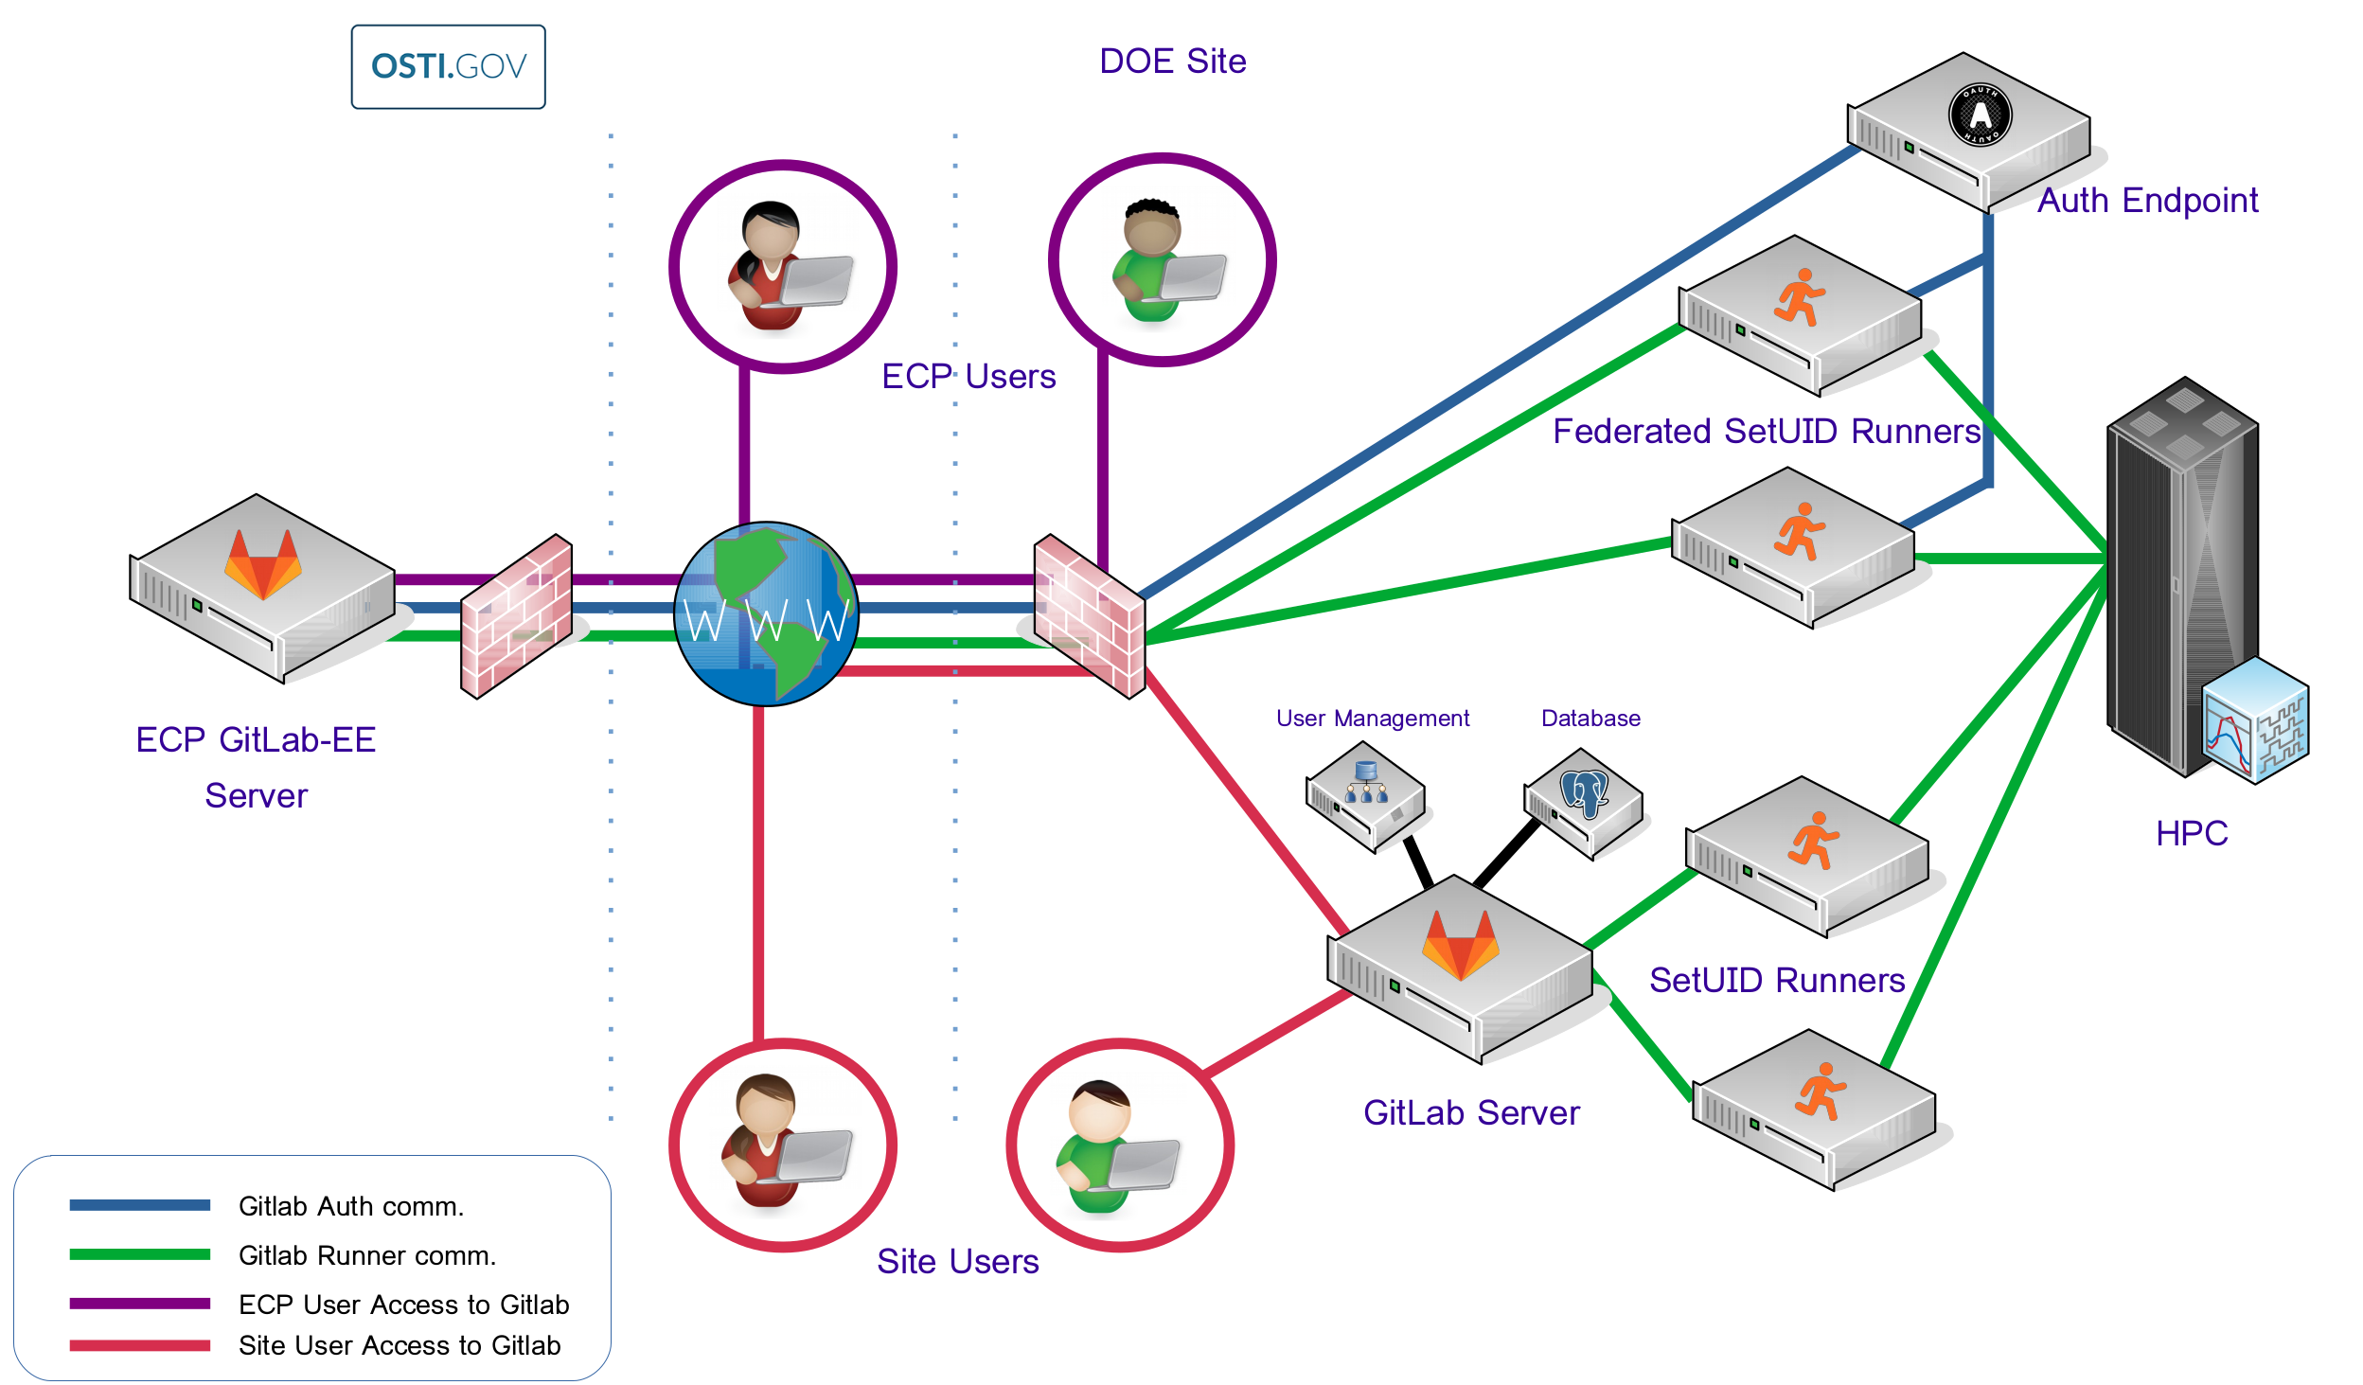
ECP CI Resources
ECP investing in GitLab for complex-wide CI
Non-GitLab projects mirror into GitLab
Complex-wide Federation via OSTI
Many hurdles still to overcome
Manual federation possible…but non-trivial
Documentation and on-boarding help
https://ecp-ci.gitlab.io
email me, miller86@llnl.gov for on-boarding contacts

Slide 11
Getting started with CI
What configuration is most important?
Examples: gcc, icc, xlc? MPI-2 or MPI-3? Python 2, 3 or 2 & 3?
What functionality is most important?
Examples: vanilla numerical kernels? OpenMP kernels? GPU kernels? All of these?
Good candidates…
A “hello world” example for your project
Once you’ve got the basics working, its easy to build up from there

Slide 12
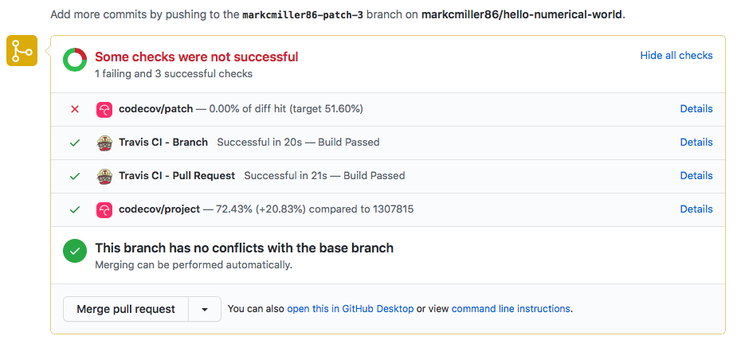
https://github.com/betterscientificsoftware/hello-numerical-world

Slide 13
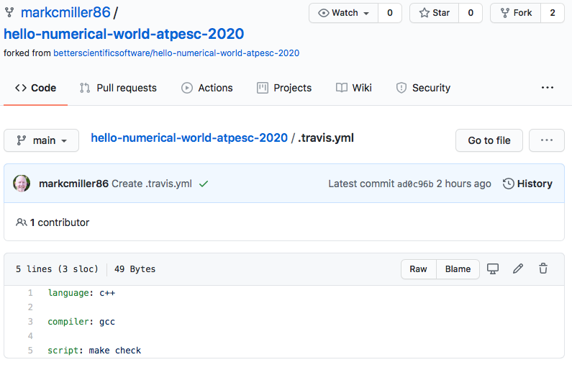
Getting started with CI:
Example .travis.yml file (also doing coverage analysis)
Setting up CI
Service | Interface
Travis | repo YAML file [& repo scripts] | /.travis.yml in root of repo
GitLab | Web page configurator + repo YAML file [& repo scripts] | /.gitlab-ci.yml in root of repo
Bamboo | Web page configurator + repo scripts
. . .

Slide 14
Getting started with CI:
Example .travis.yml file (also doing coverage analysis)
Keywords defined by service provider’s YAML docs
Specify environment
Commands to run test

Slide 15
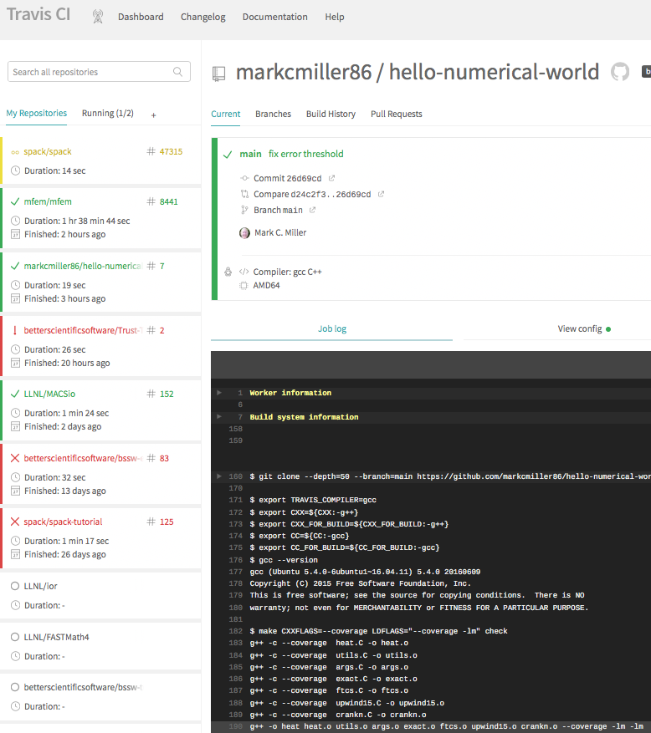
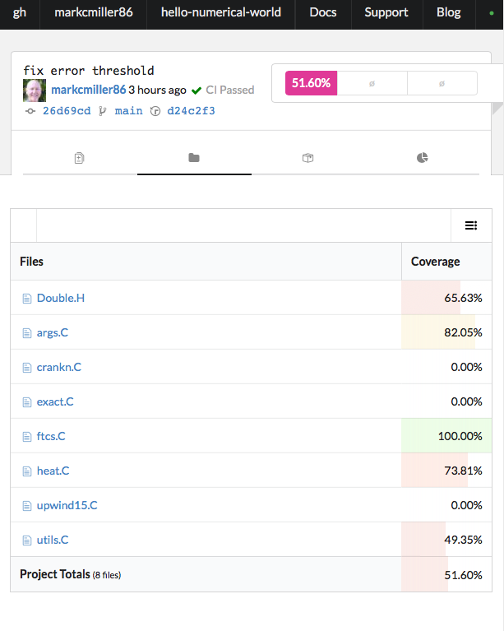
travis-ci.com
codecov.io

Slide 16

After Hours Hands-on Lesson – YouTube Video
Follow QR code to GitHub repository
You can do this exercise entirely in your browser on GitHub
Fork the repo
Create .travis.yml using
Submit Pull Request (PR)
Increase coverage
Change ‘check’ to “check_all”
Update the PR and observe coverage change
Extra credit…fail PR if coverage drops
Hint: read codecov.io docs

Slide 17
Agenda
Time (Central TZ) | Module | Topic | Speaker
9:30am-9:45am | 00 | Introduction | David E. Bernholdt, ORNL
9:45am-10:15am | 01 | Overview of Best Practices in HPC Software Development | Katherine M. Riley, ANL
10:15am-10:45am | 02 | Agile Methodologies | James M. Willenbring, SNL
10:45am-11:00am | 03 | Git Workflows | James M. Willenbring, SNL
11:00am-11:15am |  | Break (and Q&A with speakers)
11:15am-12:00pm | 04 | Software Design | Anshu Dubey, ANL
12:00pm-12:45pm | 05 | Software Testing | Anshu Dubey, ANL
12:45pm-1:45pm |  | Lunch (and Q&A with speakers)
1:45pm-2:00pm | 06 | Agile Methodologies Redux | James M. Willenbing, SNL
2:00pm-3:00pm | 07 | Refactoring | Anshu Dubey, ANL
3:00pm-3:15pm |  | Break (and Q&A with speakers)
3:15pm-3:45pm | 08 | Continuous Integration | Mark C. Miller, LLNL
3:45pm-4:30pm | 09 | Reproducibility | David E. Bernholdt, ORNL
4:30pm-4:45pm | 10 | Summary | David E. Bernholdt, ORNL

